Slide 1
GENAI Implementations

Slide 2
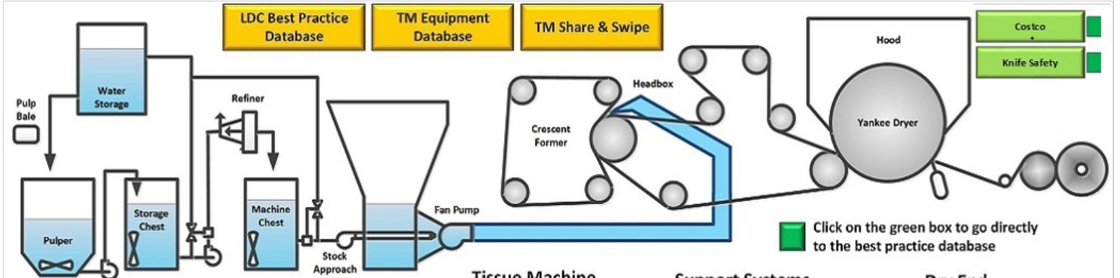
Use Case 1 : P2030 Tissue Manufacturing Best Practices

Slide 3
Use Case 1 : P2030 Tissue Manufacturing Best Practices
Manufacturing is a process driven setup and hence requires multiple best practices, SOP & process definition documents
Currently, machine operators are trained by SMEs in the mills and there are periodic refresher trainings
Training content is also loaded in a sharepoint for reference
Challenge is that with attrition, the knowledge attained is lost and a new user requires training again. Though some manual & face to face training is required, a lot of SOPs have been documented in granular format and ,if accessed, they can provide “self trainings” in many areas. Additionally, for any question after training, there is dependency on SME’s availability.
If there was a way to easily maneuver through mountain load of training docs and provide pinpointed responses to common questions, it would compliment the manual training well.

Slide 4

VIOLET
VIOLET is a LLM based bot that is hosted on MICROSOFT TEAMS. Below are some key points about violet
Data Source : P2030 Tissue Manufacturing best practices sharepoint & Tissue 2030 best practices data extract from SQLDB
Users : Primary users (~1600) are the mill workers who operate tissue manufacturing machines
KEY FEATURES
Virtual SME : Violet can provide answers related to content in P2030 in a human friendly and easy to understand language
Fast Response : After multiple optimizations we have achieved the average response time of ~10 sec
Source links : Documents that contain content related to user query are shown along with answer (as a redirect link). This helps to get any additional info.No duplicate doc links are shown.
User Feedback : User is prompted to provide feedback (optional) on response quality and his comments are logged in the backend for further analysis

Slide 5
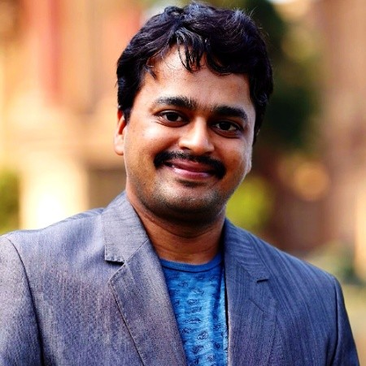
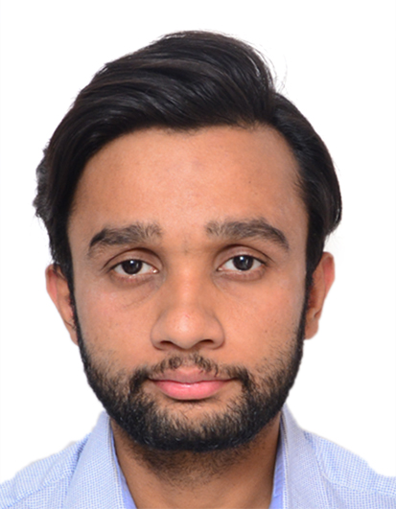
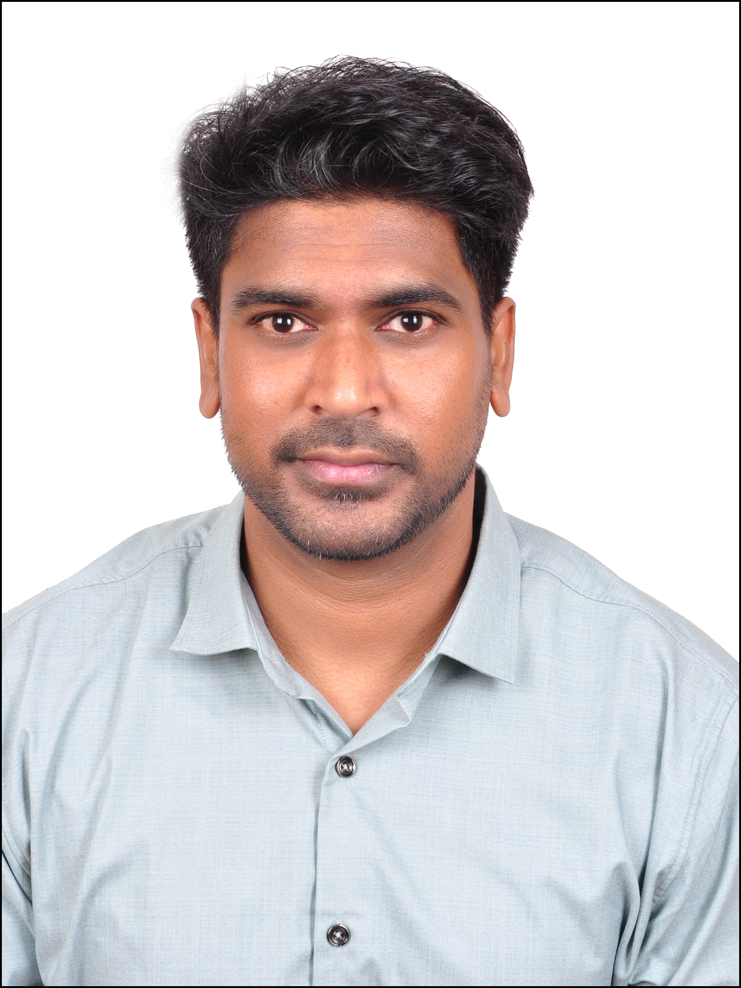
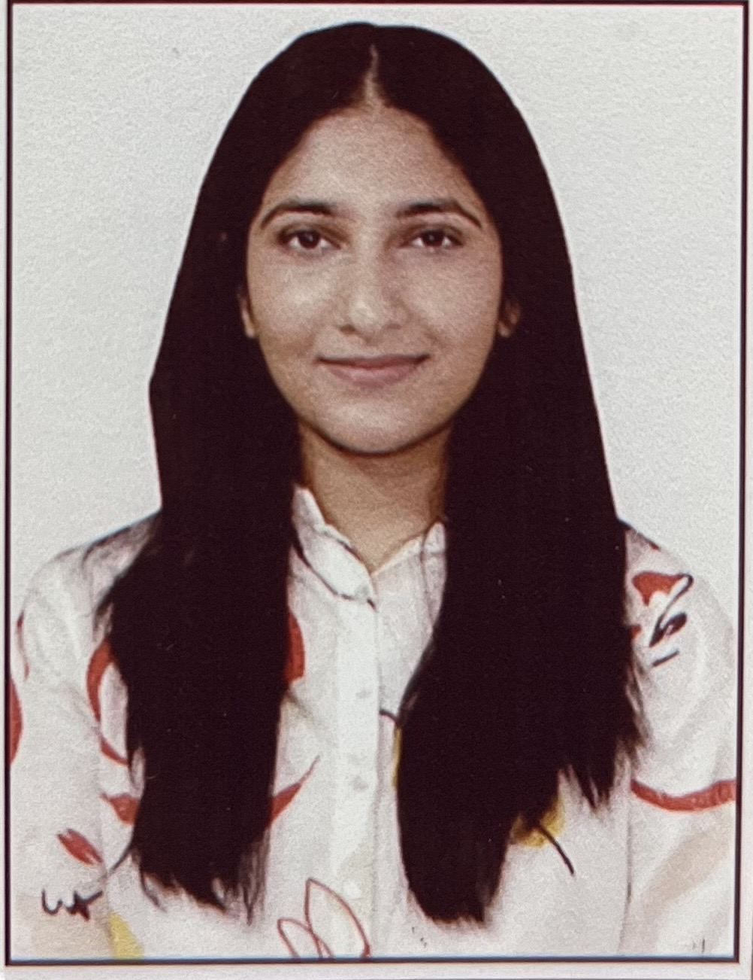

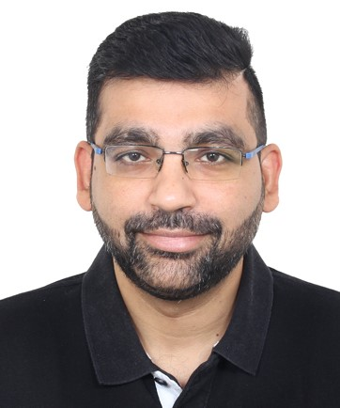

Team Behind GenAI
Aravind Peddiboyina
AI Innovation Manager
Abhishek Singhal
Varun Shivashanmugam
Ishita Gautam
Robin John
Rahul Pandey
Balakumaran Jayapal
Data Scientist
Data Engineer
Data Scientist
Product Manager
Product Owner
Solution Architect

Slide 6



Successfully delivered Violet & Procuree 2.0 using GPT 3.5(LLM)
GenAI : Summary
FIRST STEP
These are KC’s first chatbots that are powered by OpenAI’s GenAI model. For best user experience, they are integrated with MS TEAMS
Built on top of GenAI’s API framework. Under the hood it is RAG based architecture
CHALLENGES
Multiple firsts added to the complexity
Security Concerns
New OpenAI services
Constant evaluation of new LLMs
Cross functional dependencies
BENEFITS
Improved UX
Round the clock availability of virtual SME (Violet)
Eliminates need of a predefined Q&A file (Procuree)
Effective cloud resource utilization
Modular framework will enable faster turnaround for new use cases
Preservation of IP, KC data within KC’s firewall

Slide 7
GenAI : Timeline
Formal kick off of GenAI Product team
GenAI’s first workshop with Microsoft to understand OpenAI’s capabilities
Onboarded API developer to work on API development
Identified Manufacturing P2030 as potential first use case
Built MVP( python based) and initiated 1st testing with manufacturing team to gauge accuracy
Build basic POC with sample data
Got ARB’s approval on first ever API based architecture with private endpoint enabled on azure
Apr’23
July’23
Sep’23
June’23
Aug’23
Worked on the vision of taking a platform-oriented approach
First ever Azure infra set with private endpoint configured for all services
Built 1st API based architecture of GenAI platform
Extensive testing to analyze GPT 3.5 vs GPT 4 capabilities and fitment to KC’s use case

Slide 8
GenAI : Timeline
Delivered QA API to procure for UAT
Setup API infrastructure to built set of reusable APIs
Delivered Manufacturing bot (Violet) in TEAMS
Got approval to build TEAMs bot for manufacturing
Delivered Procuree’s APIs
With capability to handle different user roles
Onboarded partner team to assist in API development
Completed UAT of manufacturing using ClarkIQ application
Oct’23
Jan’24
Mar’24
Nov’23
Feb’24
Built authorization mechanism, caching mechanism to save cost
Worked on UAT feedbacks of manufacturing & TEAMS API
Built ClarkIQ (the portal for GenAI)
Worked on multiple changes in design based on Procuree’s requirement changes
Onboarded Procuree use case

Slide 9


High Level API Architecture
CHANNELS
EXP LAYER
MFG API
PROCUREE API
USECASE 3 API
USECASE 4 API
PROCESS API
GENAI PLATFORM CORE LAYER
OPENAI API
COGNITIVE API
CACHING API
REUSABLE
GENAI’S AZURE PLATFORM

Slide 10
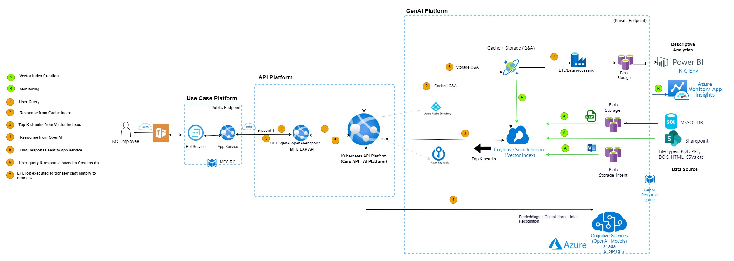
GENAI Architecture

